Slide 1
Welcome!
Question of the Day:
TBD
‹#›

Slide 2
5.4 User Errors
5.5 Assertions and Programming Logic
PROFESSOR RAMSEY
GDC 6.318
ramsey@cs.utexas.edu
Notes:
need clicker checks

Slide 3
Announcements
TBD

Slide 4
??? Quiz

Slide 5
5.4
User Input
Notes:
Session Title: Project Based Learning (PBL) for Equity in CS classes
Session Description: If you are teaching a survey course like Computer Science Principles, or a code intensive course like AP CS A, PBL can serve as a powerful tool to increase student interest and engagement. Learn about research that connects PBL to improved student outcomes, especially for girls and underrepresented minorities. Discover available PBL resources and understand PBL lesson components, so you can build your own.

Slide 6
Issues
Typos
Wrong information
Intentionally wrong information
Malicious information
Cybercrime
Check for
Type
Range
Content

Slide 7
Look Before You Buy
“Look-ahead” methods let you know something about the token waiting to be read, before you actually read it.
Input stream doesn’t change, the data isn’t returned.

Slide 8
demo1()
Consider getInt() method.
Demo

Slide 9
Write a method called getIntRange().
This method takes 2 additional parameters to define the min acceptable value (inclusive) and max acceptable value (exclusive).
The method continues to prompt for a valid integer until one is entered. It then returns the integer.
Your method must call getInt().
In-Class Practice

Slide 10
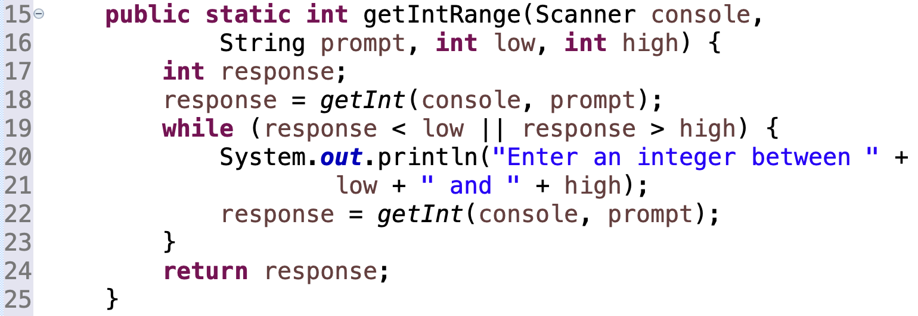
Solution

Slide 11
5.5
Assertions
Notes:
Session Title: Project Based Learning (PBL) for Equity in CS classes
Session Description: If you are teaching a survey course like Computer Science Principles, or a code intensive course like AP CS A, PBL can serve as a powerful tool to increase student interest and engagement. Learn about research that connects PBL to improved student outcomes, especially for girls and underrepresented minorities. Discover available PBL resources and understand PBL lesson components, so you can build your own.

Slide 12
Logical Assertions
assertion: A statement that is either true or false.
Examples:
Java was created in 1995.
The sky is purple.
23 is a prime number.
10 is greater than 20.
x divided by 2 equals 7. (depends on the value of x)
An assertion might be false ("The sky is purple" above), but it is still an assertion because it is a true/false statement.

Slide 13
Reasoning about Assertions
Suppose you have the following code:
if (x > 3) {
// Point A
x--;
} else {
// Point B
x++;
// Point C
}
// Point D
What do you know about x's value at the three points?
Is x > 3? Always? Sometimes? Never?

Slide 14
Assertions in Code
We can make assertions about our code and ask whether they are true at various points in the code. Valid answers are ALWAYS, NEVER, or SOMETIMES.
System.out.print("Type a nonnegative number: ");
double number = console.nextDouble();
// Point A: is number < 0.0 here?
while (number < 0.0) {
// Point B: is number < 0.0 here?
System.out.print("Negative; try again: ");
number = console.nextDouble();
// Point C: is number < 0.0 here?
}
// Point D: is number < 0.0 here?
(SOMETIMES)
(ALWAYS)
(SOMETIMES)
(NEVER)

Slide 15
Patterns to Remember
Right after a variable is initialized, its value is known:
int x = 3;
// is x > 0?
In general you know nothing about parameters' values:
public static void mystery(int a, int b) {
// is a == 10?
But inside an if, while, etc., you may know something:
public static void mystery(int a, int b) {
if (a < 0) {
// is a == 10?
...
}
}
ALWAYS
SOMETIMES
NEVER

Slide 16
Assertions and Loops 1
At the start of a loop's body, the loop's test must be true:
while (y < 10) {
// is y < 10?
...
}
After a loop, the loop's test must be false:
while (y < 10) {
...
}
// is y < 10?
Inside a loop's body, the loop's test may become false:
while (y < 10) {
y++;
// is y < 10?
}
Must consider both conditions - loop has never run and loop has run one or more times.
ALWAYS
NEVER
SOMETIMES

Slide 17
Assertions and Loops 2
Consider this loop:
int y = console.nextInt();
while (y < 10 && !done) {
...
y++;
...
}
// is y == 10?
Three cases:
The loop never runs.
The loop runs until test is false.
The loop is partially run.

Slide 18
“Sometimes”
Things that cause a variable's value to be unknown (often leads to "sometimes" answers):
Reading from a Scanner
Reading a number from a Random object
A parameter’s initial value to a method
Changes to a value after a known state
If you can reach a part of the program both with the answer being "yes" and the answer being "no", then the correct answer is "sometimes".
If you're unsure, "Sometimes" is a good guess.

Slide 19
Note: Do Demo and Practice on Doc Cam with printout.

Slide 20
Demo
// assumption: y > 0
public static void mystery(int x, int y) {
int z = 0;
// Point A
while (x >= y) {
// Point B
x = x - y;
z++;
if (x != y) {
// Point C
z = z * 2;
}
// Point D
}
// Point E
System.out.println(z);
}
Choose A(Always), N(Never), or S(SOMETIMES).
 | S | S | A
 | N | S | S
 | S | N | N
 | S | S | N
 | A | N | S
 | x < y | x == y | z == 0
Point A
Point B
Point C
Point D
Point E

Slide 21
In-Class Practice
public static int mystery(Scanner console) {
int prev = 0;
int count = 0;
int next = console.nextInt();
// Point A
while (next != 0) {
// Point B
if (next == prev) {
// Point C
count++;
}
prev = next;
next = console.nextInt();
// Point D
}
// Point E
return count;
}
Choose A(Always), N(Never), or S(SOMETIMES).
 | S | A | S
 | N | S | S
 | N | N | A
 | S | N | S
 | A | S | S
 | next == 0 | prev == 0 | next == prev
Point A
Point B
Point C
Point D
Point E

Slide 22
In-Class Practice
// Assumes y >= 0, and returns x^y
public static int pow(int x, int y) {
int prod = 1;
// Point A
while (y > 0) {
// Point B
if (y % 2 == 0) {
// Point C
x = x * x;
y = y / 2;
// Point D
} else {
// Point E
prod = prod * x;
y--;
// Point F
}
}
// Point G
return prod;
}
Choose A(Always), N(Never), or S(SOMETIMES).
 | y > 0 | y % 2 == 0
Point A | S | S
Point B | A | S
Point C | A | A
Point D | A | S
Point E | A | N
Point F | S | A
Point G | N | A
 | y > 0 | y % 2 == 0
Point A
Point B
Point C
Point D
Point E
Point F
Point G

Slide 23
Assertion Tips
Tip 1 - Point inside a loop:
You know test is true immediately after test
Anywhere in loop, consider 1) first time through loop 2) additional times through loop
Tip 2 - Point inside an if statement:
You know the test is true immediately after test
Tip 3 - Change or no change?
Example 1 - If an assertion for the value x is always true at point B, it will be the same at Point C, because there are no changes to x in-between.
Example 2 - If an assertion for the value y is always true at Point C, you don’t know if this is the case at Point D, because y has changed. More information is needed.
Example 3 - Consider interaction of multiple tests. Point C knows y > 0 and this can impact the result of y % 2 == 0.
Tip 4 - Point after a loop:
Consider 1) the loop executed one or more times and 2) the loop did not execute
Example - At point G, the assertion y > 0 is true if the loop executed, but if it didn’t and 0 was passed in for y to the method (method assumes y >= 0), then loop won’t run and y would still be 0.
// Assumes y >= 0, and returns x^y
public static int pow(int x, int y) {
int prod = 1;
// Point A
while (y > 0) {
// Point B
if (y % 2 == 0) {
// Point C
x = x * x;
y = y / 2;
// Point D
} else {
// Point E
prod = prod * x;
y--;
// Point F
}
}
// Point G
return prod;
}

Slide 24
Remember
You Belong Here
TBD
Hi!

